Slide 1
The Computer

Slide 2
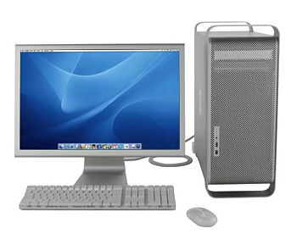
THE COMPUTER
.

Slide 3
Computer: Is an advanced electronic device that takes raw data as input from the user and processes these data under the control of set of instructions (called program) and gives the result (output) and saves output for the future use.
Or
Computer: Is an electronic device which input data, process under the set of instructions (programs) it and provide output which is information.
It can process both numerical and non-numerical (arithmetic and logical) calculations.
It accept all types of data such as Text information, Sound clips, Picture, Diagrams and maps (graphics), Video and Animation

Slide 4
Computer system
Is the collection of components namely hardware, software, liveware (people), data and procedure that work together to receive, process, manage and present information
Hardware: are physical tangible components that make up a computer
Software: refers to the set of instructions that directs a computer what to do.
Liveware (people): users who dictates what task he/she wants the computer to perform.
Data: can be in the form of written documents, programs, pictures, sound, video or combination of them.
Procedure: rules or guidelines for people to follow when using software, hardware and data, they are typically documented in manuals

Slide 5
Significance of Computer
The computer is a device that helps us work at faster speed and thus they save our times.
Computer runs on energy supplied by electricity, so they save our energy.
Computer produces accurate results, thus they save us from errors and mistakes
They can help you automate various tasks that you cannot do manually. They can help you organize your data and information.

Slide 6
Characteristics of a Computer
Computer is one of the most revolutionary and powerful tools ever developed, which is characterized by the following features:-
Speed: A computer does its jobs very speedily. It never slows down and keeps working at a uniform speed. It speed is measured in microseconds (1/millionth seconds) and in even smaller units.
Accuracy: A computer never makes errors normally. But errors may occur in its hardware. Usually, errors are committed by the operator in feeding the data.
Storage: A computer’s system unit is capable of storing a large amount of data in its memory. Not only this, it can produce the data again and again on demand. A Human brain can never do that.

Slide 7
Tirelessness: Unlike human –beings and other animals, a computer never get tired or bored if it has to do the same job again and again.
Versatility: A computer is capable of performing a large number of different jobs working logically step by step.
Artificial intelligence: ability of computer to mimic (copy, imitate) human behaviors

Slide 8
Computer Applications (areas where computer is used)
Computers have greatly changed man’s way of life. This is because computers can mimic man’s activities at improved speed.
Computer can be used in various key areas as follows:-
Computer in Education
Computer are being used in education in a variety ways. In school both teachers and students used computer for Gathering information from the internet, Develops science projects, Teaching and Learning.
Computer in Health
Computers provide better services in hospitals. They are used to monitor a patient's condition like temperature and heart beat and sounds an alarm if there is any change from normal.

Slide 9
In Health, computer are used for:
Diagnosing illness
Monitoring patients health development
Assisting surgeons
Medical students can practice operations on computers
Computer at Home
People use computer at home for:-
Storing personal information, educational purpose, communication (email and Skype) and publication.
Computer in Security
Computer are used to control the movement of people within a limited area by connecting it to the camera.
Computer in Science, Research and Engineering- Professionals use the computer as a tool to experiment, design and develop their ideas/projects.

Slide 10
Computer in Business
Many businesses large and small use computer to help in the control of daily activities such as, Budgeting, Billing, Accounting and Advertising.
Computer in Offices
Offices has being using computers to perform various functions such as message distribution, record keeping and the filling and classifying of documents
Computer in banks
computers are widely used for keeping customer records, cash deposits and withdrawal, the use of Automated Teller Machine (ATM)
Computer in supermarkets
computer is used in the management of daily activities like stock control

Slide 11
Stages of Processing in Computer
The computer receives the data that we feed into it, Stores the data inside it and processes the data according to instructions, and generates the desired output.
When the computer processes data it actually performs a number of separate functions as follows:-
Stages of Processing
Input: The computer accepts data from outside for processing through inputs devices,
Processing: The computer performs operation on the data it holds within
Output: The computer produces data from within for external use.
Input
Processing
Output

Slide 12
Computer Functions/Operation
A computer can process data, pictures, sound and graphics. They can solve highly complicated problems quickly and accurately.
A computer performs basically five major computer operations or functions irrespective of their size and make.
These are:
It accepts data or instructions by way of input,
It stores data
it can process data as required by the user,
It gives results in the form of output, and
It controls all operations inside a computer.

Slide 13
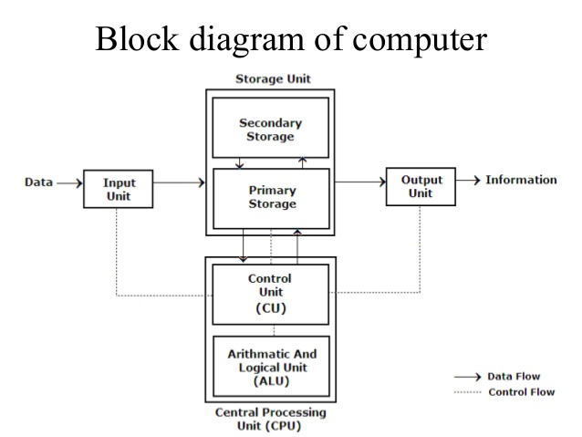

Slide 14
Computer Hardware
Hardware is all the parts of a computer systems you can see and touch. It is all devices that make up the computer system. These devices are also called peripherals.
Computer hardware comprises the following
Input Devices | Processing Devices | Output Device | Storage Devices
Keyboard Mouse Trackball Joystick Scanner Microphone Barcodes Reader Magnetic Stripe Reader | System Unit(CPU) | Printer Speaker Monitor Plotter Projector Fax | Hard Disk Flash Disk Compact Disk (CD) Digital Versatile Disk (DVD) Floppy Disk Random Access Memory (RAM) Read Only Memory (ROM) SD Card

Slide 15
Fundamental parts of Computer
Fundamental parts are the basic parts of a computer, there are four fundamental parts of the computer, which are as follows:
Keyboard (b) Mouse (c) Monitor/screen/VDU (d)System unit
Monitor
System unit (CPU)
Keyboard
Mouse

Slide 16
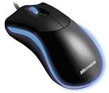
Input Devices
Input devices - Are devices which enable a computer user to enter data, commands, and programs into the computer.
The most common types of input devices are:
Mouse
The mouse is used to control the movement of a pointer on the screen when it is moved horizontally over a flat surface.
Uses:
Movement – Controlling a screen pointer
Buttons – Selecting items(Left button)
- Menus/options (Right button)

Slide 17
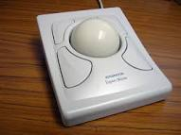
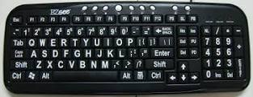
Functions of the mouse
Click, double click, right click, dragging, scrolling.
Trackball
A trackball is used in the same way as a mouse but it is useful where desk space is limited.
Standard Keyboard
It is the most important input device, it has small keys which are used to feed data.
The Standard keyboard commonly used is QWERTY keyboard

Slide 18
Keyboard keys can be classified/ grouped into five categories.
Alphanumeric (typing/letter)keys: contains letters A-Z, numbers, arranged in a line, special symbols e.g. ?, %, caps lock, tab, enter etc.
Function keys: are located along the top of the keyboard, they are used for tasks that occurs frequently in various programs. E.g. F1, F2… F12
Navigation and editing keys: used to control the cursor or pointer and edit text, they include Delete (Del), PgUp, PgDn, End
Special purpose keys: used in combination with other keys as a shortcut to commands e.g. Ctrl, Alt, Shift and Esc.
Numeric keypads: consist of set of numbers 0-9, and the arithmetic signs like +, -, *, and /.
numeric keypad can only be used when the Num lock key is on

Slide 19
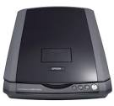
Scanner
These are input devices used to digitize images of pages or objects into softcopy.
A light moves slowly over the surface of the picture or object to be scanned. The colors of the reflected light are detected and digitized to build up a digital image.
The digital data can then be saved by a computer as an image file.
Magnetic Stripe reader
Magnetic stripes are thin strips of magnetic tape which are usually found on the back of plastic credit and debit cards. E.g. Automatic Teller Machine (ATM)

Slide 20
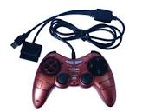
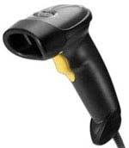
Joystick – Are usually used for playing computer games.
Barcode reader - Electronic device that scans a barcode by shining a laser beam on it. Barcode readers (unlike magnetic-stripe readers) are non contact automatic data capture devices, operate only at short distances (a few inches).

Slide 21
Microphone – This is used for the input of sound which is then digitized by the computer.
Voice recognition software can be used to convert your voice into text or to control menu options
System Unit
A system unit is the part of a computer that houses the primary devices that perform operations and produce results for complex calculations. It includes the motherboard, CPU, RAM and other components, as well as the case in which these devices are housed. This unit is also known as a chassis or a tower in layman's terms, and it performs the majority of the functions that a computer is required to do.
The term system unit is generally used to differentiate between the computer itself and its peripheral devices, such as the keyboard, mouse and monitor.

Slide 22
Central Processing Unit(CPU)
The central Processing Unit (CPU), brain of the computer, processor, central processor, or microprocessor – Is the devices which is responsible for handling all instructions it receives from hardware and software running on the computer.
The CPU is the control centre for a computer. The CPU guides, directs and controls a computer's performance.
The CPU has two main components
Control Unit (CU)
Arithmetic Logic Unit (ALU)

Slide 23
Control Unit
The control Unit tells the part of the computer system how to carry out programs instructions. It directs the movement of electronic signals between memories. It control the entire process in the computer.
Whenever an input reaches into memory, the Control Unit determines what type of instructions is required.
Arithmetic Logic Unit
Arithmetic Logic Unit, usually is called ALU, performs arithmetic and logic operations.
Arithmetic operations are: addition (+), Subtraction (-), Division (/) and Multiplication (x) in a computer.
The logic operations are comparisons operations e.g. less than (<), greater than (>), equal to (=), less than or equal to (≤), greater than or equal to (≥) and not equal (≠)

Slide 24
Output Devices
Output device – Is the device which display information that has been held or generated within a computer.
Example of output devices:- Printer, monitor, speaker and plotter, projector etc.
Categories of output
Soft Copy output- an output which is displayed on the screen or saved in the storage media such as flash disk.
Hardcopy output- an output which is produced on papers.

Slide 25
Soft Copy output devices
Monitors - Alternatively referred to as a Video Display Terminal (VDT) and Video Display Unit (VDU),a monitor is a video display screen for computer.
Types of monitors
Cathode Ray Tube (CRT)
Liquid Crystal Display (LCD)
Light Emitting Diode (LED)
Speakers – Are used to output sound from a computer.
Projector – used to display output from a computer on a plain screen like a wall or whiteboard.
Hardcopy output devices
Plotter - is a computer hardware device similar to a printer that uses a pen, pencil, marker or other writing tool to make a design. Often these printers are used in schematics, Computer Aided Design (CAD), and other print jobs

Slide 26
Printers – Is an output device that prints paper documents. This includes text documents, images, or a combination of both.
The quality of the hard copy depends on the printer’s printing mechanism.
There are two types of printers.
Impact printers
Non-Impact printers
Impact printers
An Impact printer – Is a type of printer that operates by striking a metal or plastic head against an ink ribbon to produce a text and graphics on a piece of paper. e.g. Dot-Matrix printer

Slide 27
Non-Impact Printer
Non-Impact Printer is a type of printer which do not use the striking mechanism to produce text and graphics on a piece of paper.
They do not hammer the ribbon hence they are much quieter. E.g. Inkjet printer(prints in colour), laser printer(black and white, uses toner), thermal printer and photo printer
Differences between Impact and Non-Impact printers.
 | Impact printer | Non-Impact printer
1 | Low printing speed | Reasonably fast
2 | Low print quality | High quality of output, capable of printing fine and smooth details
3 | Not commonly used today | Most commonly used printer today

Slide 28
4 | Generally noisy because of the striking activity | Generally much quieter because there is no striking mechanism
5 | Limited color printing | Capable of printing in strong clear color, good for printing pictures
6 | Uses ink ribbon | Uses ink spray or toner powder
7 | Less expensive | More expensive
8 | Reliable, durable (lasting for a long time) | Easily to get damage

Slide 29
Storage Unit
All computers need to store and retrieve data for processing.
A storage unit - Is a fixed unit of physical memory allocated to store a certain data in a computer.
Storage can be grouped into two categories:
Primary storage
Secondary storage
Primary Storage
The primary storage also called main memory or Immediate Access Store (IMAS), reside in the computer.
Primary storage - is the main area in a computer where information is stored for quick/direct access by the computer’s processor.
This is necessary since the processing unit can only act on data and instructions that are held in primary storage.

Slide 30
Primary storage consists of two types of memory chips.
Random Access Memory (RAM)
Read Only Memory (ROM)
Random Access Memory (RAM) - Is a memory used in computers to store temporary instructions and data needed to complete tasks. It is also referred to as working storage or volatile memory since it loses its data once the power is switched off.
Cache memory - Is random access memory (RAM) that a computer microprocessor can access more quickly than it can access regular RAM.
Read Only Memory (ROM) – Is a memory which hold data and instructions permanently necessary for starting up the computer when it is switched on. It is Non-volatile.
The information is fixed at the time of manufacture.

Slide 31
The first thing that a computer does when it boots is to perform what is called the (POST)“Power-On Self-Test” for short.
The POST - Is a built-in diagnostic program that checks the hardware to ensure that everything is present and functioning properly, before the BIOS begins the actual boot.
BIOS (Basic Input/ Output System) - is an electronic set of instructions that a Personal Computer (PC) uses to successfully start up. It is located on a chip on the motherboard inside of a computer and is designed to be protected from disk failure.
Boot – Is to load an operating system into the computer's main memory or random access memory (RAM).

Slide 32
The Function of BIOS
One of the main functions of the BIOS is to give instructions for the Power-On Self Test (POST). This self test ensures that the computer has all of the necessary parts and functionality needed to successfully start itself, such as use of memory and a keyboard and other components. If errors are detected during the test, the computer gives a code that reveals the problem. Error codes are typically presented as a series of beeps heard shortly after startup or error message can be displayed on the screen.

Slide 33
Types Read Only Memory (ROM)
There are five basic types of ROM:
ROM - Read Only Memory
PROM - Programmable Read Only Memory
EPROM - Erasable Programmable Read Only Memory
EEPROM - Electrically Erasable Programmable Read Only Memory
Flash EEPROM memory
Each type has unique characteristics, but all types of ROM memory have two things in common:
Data stored in these chips is non-volatile - it is not lost when power is removed.
Data stored in these chips is either unchangeable or requires a special operation to change.

Slide 34
Secondary Storage
Secondary storage also known as Auxiliary storage, Secondary memory or External memory - Is the device of computer that store information such as software and data permanently.
This is the memory which is used to store a large amount of data found inside and outside computer system unit and it is Non-volatile.
Forms of Auxiliary(Secondary) Memory
Flash memory: An electronic non-volatile computer storage device that can be electrically erased and reprogrammed, and works without any moving parts. Examples of this are Universal Serial Bus(USB)flash drives
Optical disc: It's a storage medium from which data is read and to which it is written by lasers.

Slide 35
There are three basic types of optical disks:
CD-ROM (Compact Disk Read Only Memory),
WORM (Write Once Read Many e.g. Compact Disk-Recordable (CD-R), Digital Versatile Disk-Recordable(DVD-R)) and
EOD (Erasable Optical Disks e.g. Compact Disk Re-Writable (CD-RW) or Digital Versatile Disk Re-Writable (DVD-RW)).
Examples of Optical disc: Compact Disk (CD),Digital Versatile Disk(DVD),Video Compact Disk(VCD)
Magnetic Disk: A magnetic disk is a circular plate constructed of metal or plastic coated with magnetized material. Both sides of the disk are used and several disks may be stacked on one spindle with read/write heads available on each surface. Tracks are commonly divided into sections called sectors. Examples are Floppy disk and Hard-Disk-Drives (HDD)
Magnetic tapes: The tape itself is a strip of plastic coated with a magnetic recording medium. Bits are recorded as magnetic spots on tape along several tracks. E.g. Video Home System (VHS).

Slide 36
Units of storage
The amount of data and instructions that can be stored in the memory of a computer or secondary storage is measured in bits.
Bit - Is the smallest unit of storage in a computer.
A Bytes/character – Is made up of a combination of eight bits.
Conversions
Bit is 0 or 1
8 Bits = 1 byte
1024 Bytes = 1 Kilobytes (1 KB)
1024 Kilobytes = 1 Megabytes ( 1 MB)
1024 Megabytes = 1 Gigabytes (1 GB)
1024 Gigabytes = 1 Terabytes (1 TB)

Slide 37
Capacity of storage in different storage devices
Storage Device | Storage Capacity
CD | 700 MB
DVD | 4.7 GB up to 17 GB
USB Flash | 1 GB up to 32 GB
HDD | 10 GB up to 1 TB

Slide 38
 | Primary Storage | Secondary Storage
1 | Considered as the main memory | Considered as an additional memory
2 | Most Primary Storage is temporary | All secondary storage is permanent
3 | Primary Storage is expensive and smaller in size | Secondary storage is usually cheaper and large in size
4 | Primary storage is smaller in capacity of storage | Secondary Storage is bigger in capacity of storage
5 | Primary storage is usually faster | Secondary storage is slower
6 | Located close to CPU | Not close to CPU
7 | Consist RAM and ROM | Consist HDD,CD,DVD,USB
Differences between Primary and Secondary storage.

Slide 39
Bit
Byte
Kilobyte
Megabyte
Gigabyte
Terabyte
Petabyte
Exabyte
Zettabyte
Yottabyte
Kibibyte
Mebibyte
Gibibyte
Tebibyte
Pebibyte
Exbibyte
zebibyte

